Slide 1

Gym & Nutrition
-: Presented By :-
Mukunda D - 1AY18MCA09
Fenil Patel - 1AY18MCA18

Slide 2
Introduction
Our Gym management provides lots of functions such keeping records of all the things about customer’s fees, plan, and physical fitness which help to provide good quality of services to customer from Gym.
Gym Management System is an online service that can be setup for your gym to help detail about classes, memberships detail, receive payments , online classes, customer management, and online store so you can purchase products (nutrition and supplements) to your customers.
And also we provide extra activity like cycling, swimming, yoga and etc.

Slide 3
Module
Admin :
ADMIN
Admin is the role with the highest level of access in website. Admin can add content on all pages and access all items in the Admin. This means that Admin can control site. They can add, update and delete content.
User :
You User have note major role in site. User can get the detail about class, schedule , nutrition product, trainer detail and membership plan and user can comment and contact without login.
Fitness & Nutrition
USER

Slide 4

Pages
User :
Admin :
Home
Dashboard
More
component
Schedule
Forms
Trainers
Tables
About us
Contact us

Slide 5
Design
Text Here
Get a modern PowerPoint Presentation that is beautifully designed.
04
Text Here
Fitness
&
Nutrition
03
Get a modern PowerPoint Presentation that is beautifully designed.
USER
ADMIN
Text Here
Get a modern PowerPoint Presentation that is beautifully designed.
02
01
Text Here
Get a modern PowerPoint Presentation that is beautifully designed.

Slide 6
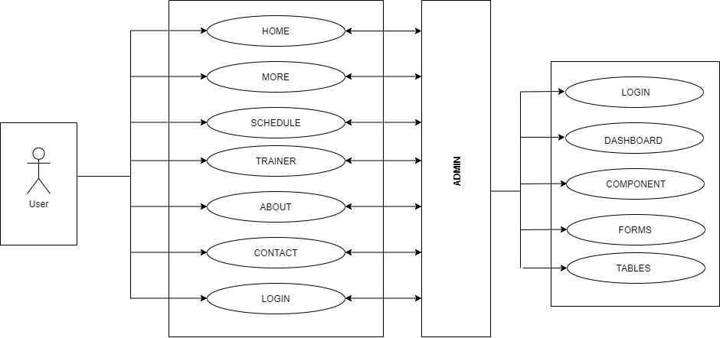

Flow Diagram
Text Here
Get a modern PowerPoint Presentation that is beautifully designed.
04
Text Here
03
Get a modern PowerPoint Presentation that is beautifully designed.
Text Here
Get a modern PowerPoint Presentation that is beautifully designed.
02
Text Here
01
Get a modern PowerPoint Presentation that is beautifully designed.

Slide 7
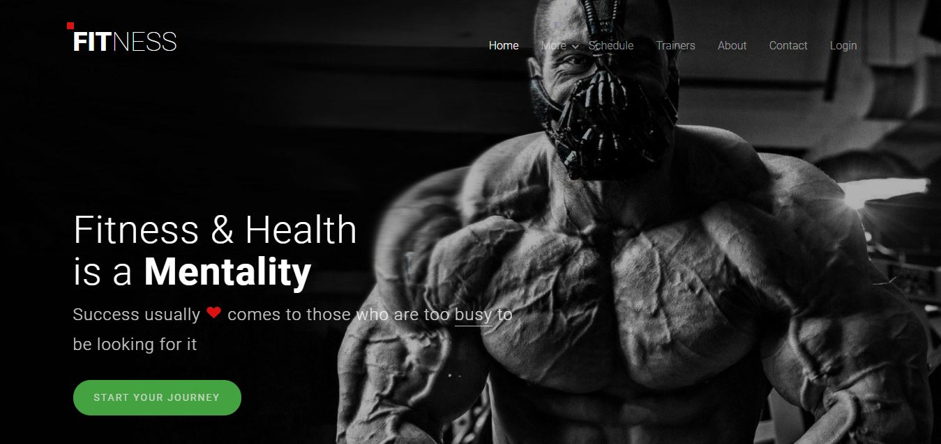
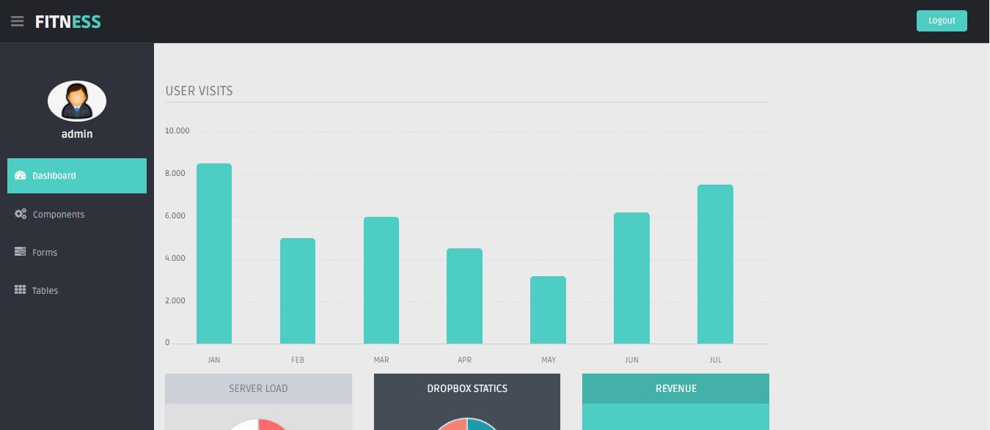
Screenshots
User :
You can simply seen the detail about the gym classes and schedule.
Admin :
Here admin can saws the detail about visitors .

Slide 8
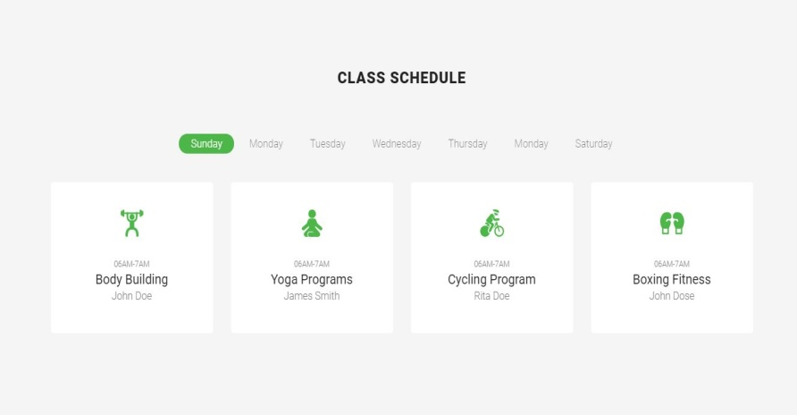

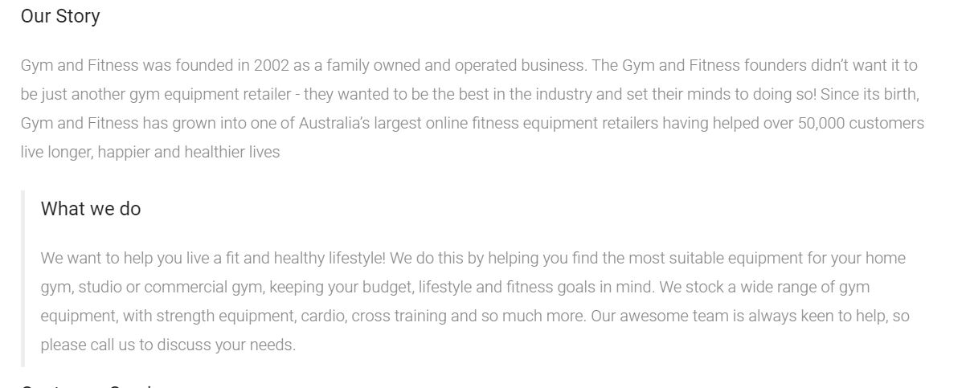
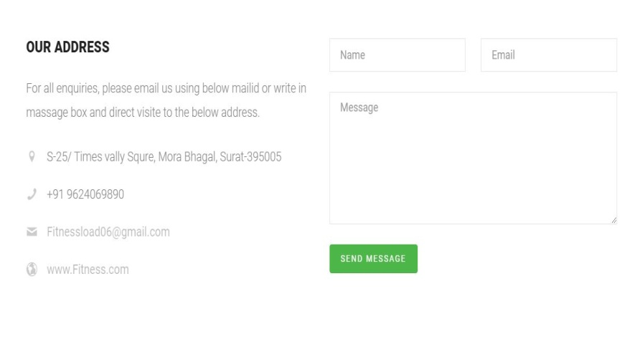
User Screenshots
03
Schedule
Trainers
About
Contact

Slide 9
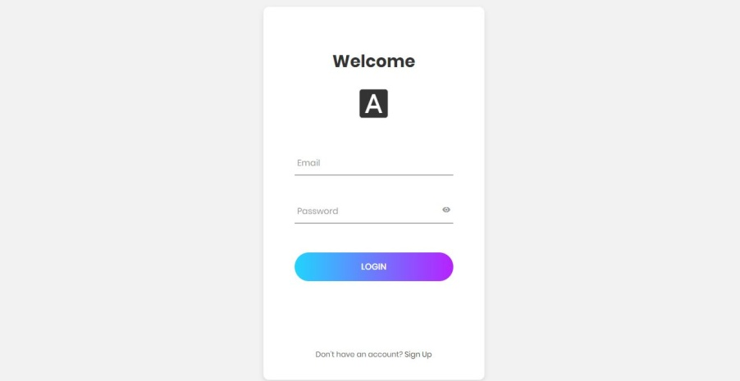
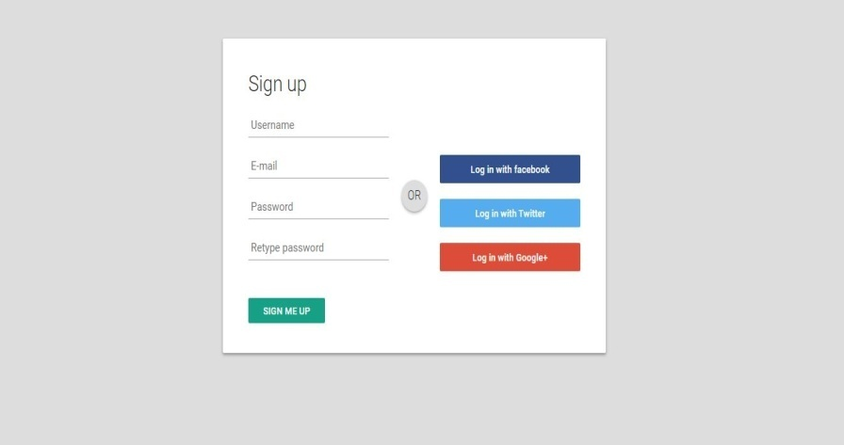
User Screenshots
03
login
Signup

Slide 10
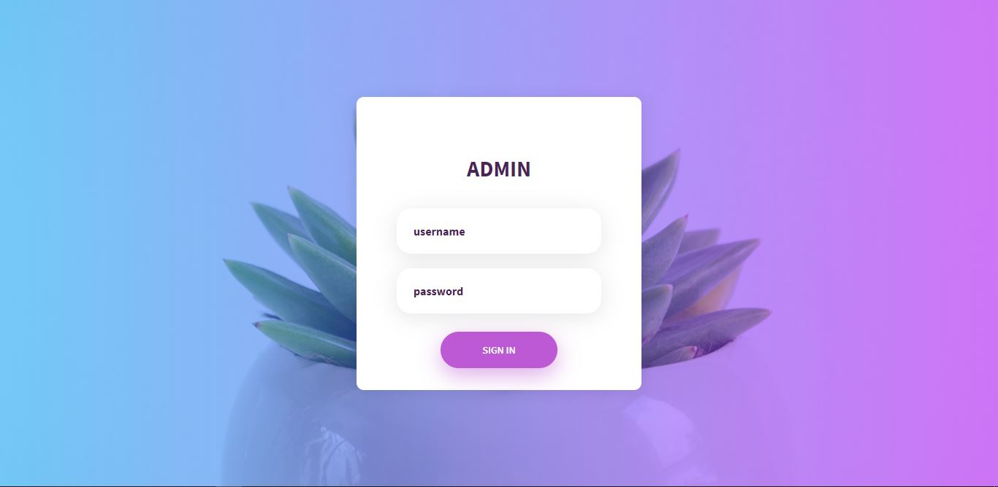
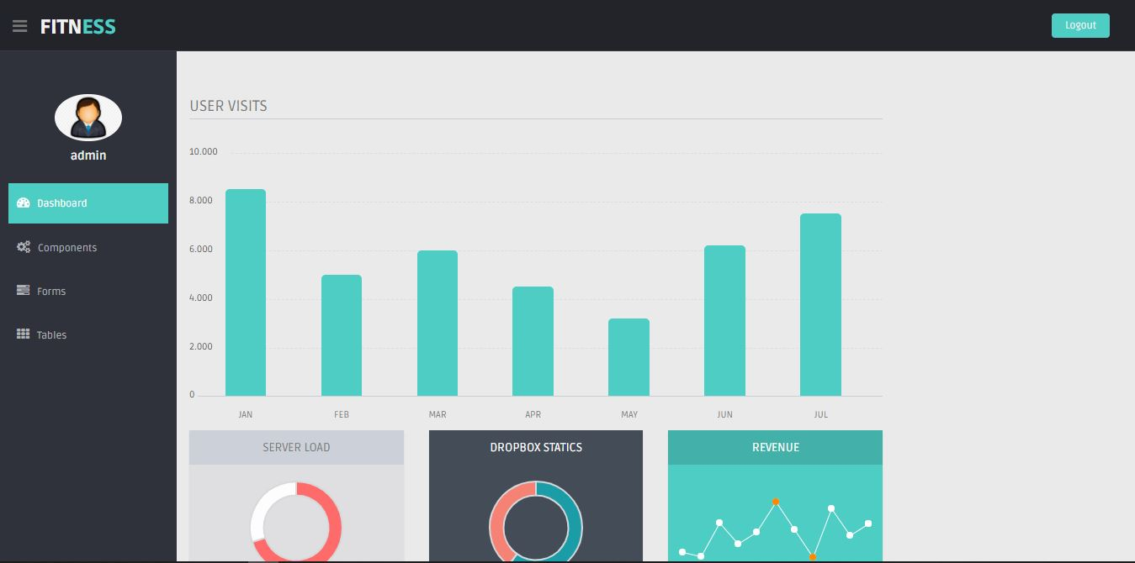
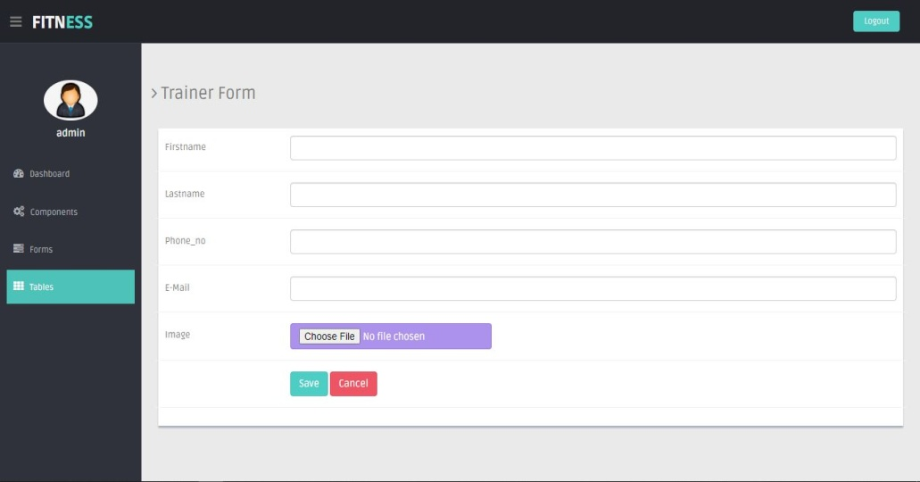
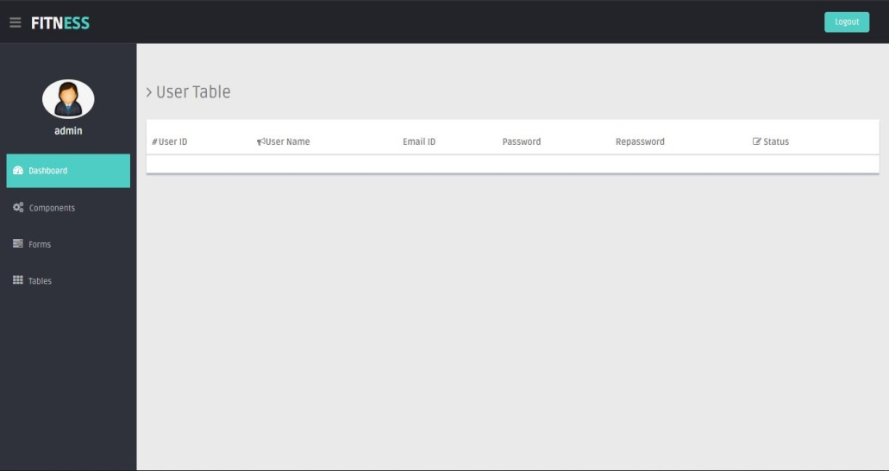
Admin Screenshots
login
Dashboard
Form
Table

Slide 11
Conclusion
Customers no need to travel to the gyms. This System saves a lot of Time, money and effort to the customers.
Customers can contact your admin here, You can take suggestions and ask questions and queries. Its very Useful for two way communication.
According to the trainers suggestions customers can order every Nutritious Products from the the same Site.
Admin Can see the count and status of the customers. Admin can analyze the statistics of the gym for better improvements.

Slide 12

Future Enhancement
01
We can save the video lectures.so customers can do workouts at their flexible timings.
.
02
We can use the same video lectures for new beginners for basic introduction.
03
We can add some personality development courses in future.

Slide 13
Thank You

